Slide 1
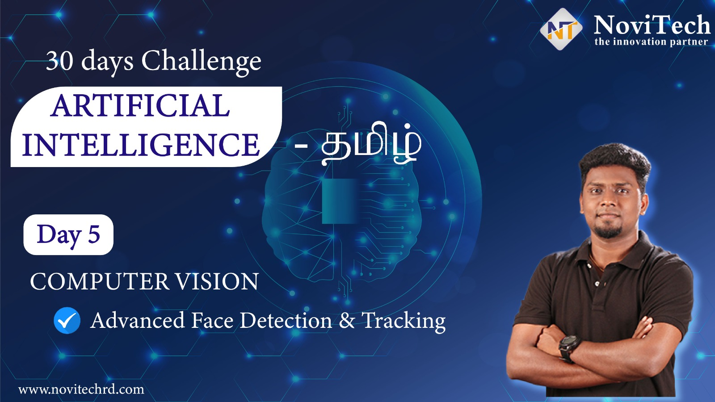

Slide 2
Announcement
Attendance link will be shared in between the session
Minimum 28 Days Attendance required to receive your FREE E-CERTIFICATE (with same mobile number & email id)

Slide 3
Prerequisites for this Course
Laptop with Good Internet
No basic knowledge is required.
Note & Pen

Slide 4
Face Detection
Face detection is a computer technology being used in a variety of applications that identifies human faces in digital images.
With face detection, you can get the information you need to perform tasks like embellishing selfies and portraits, or generating avatars from a user's photo. Because ML Kit can perform face detection in real time, you can use it in applications like video chat or games that respond to the player's expressions

Slide 5
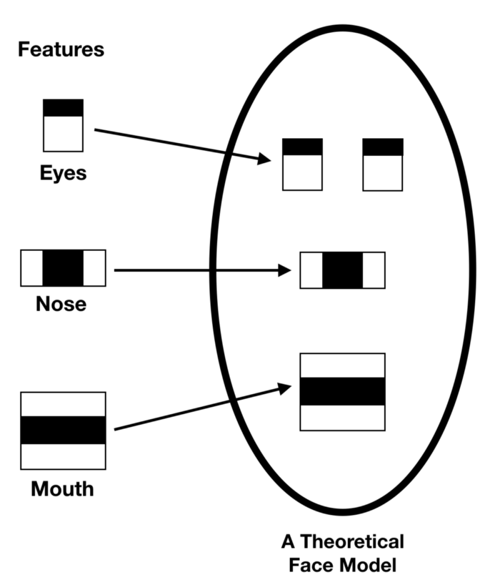
Haar Cascade FrontalFace Algorithm
It is based on the Haar Wavelet technique to analyze pixels in the image into squares by function.
This uses machine learning techniques to get a high degree of accuracy from what is called “training data”.
This uses “integral image” concepts to compute the “features” detected.
Haar Cascades use the Adaboost learning algorithm which selects a small number of important features from a large set to give an efficient result of classifiers.

Slide 6
detectMultiScale
#faces = face_cascade.detectMultiScale(src, scalefactor,minNeighbors)
faces = face_cascade.detectMultiScale(img, 1.3, 4)
scaleFactor — Parameter specifying how much the image size is reduced at each image scale.
minNeighbors — Parameter specifying how many neighbors each candidate
rectangle should have to retain it.

Slide 7
Block Diagram – Workflow of Face Detection
Loading HaarCascadeFace Algorithm
Initializing Camera
Reading Frame from Camera
Converting Color image into Grayscale Image
Obtaining Face coordinates by passing algorithm
Drawing Rectangle on the Face Coordinates
Display the output Frame

Slide 8
Ready For Hands On

Slide 9


Solution - Internship
30 Day Recorded Video Lectures (₹4000)
20+ Projects (₹30,000)
Bonus Task, Assignments (₹1,500)
Technical Material(PPT, Mindmap) (₹1,000)
Rs.40,000
100 AI Interview Questions(1500)
Rs.1,999
Hand Signed Printed Certificate For Internship with your Photocopy (₹2,000)
Live Q&A Session on next 5 Saturdays
Lifetime Course Validity

Slide 10
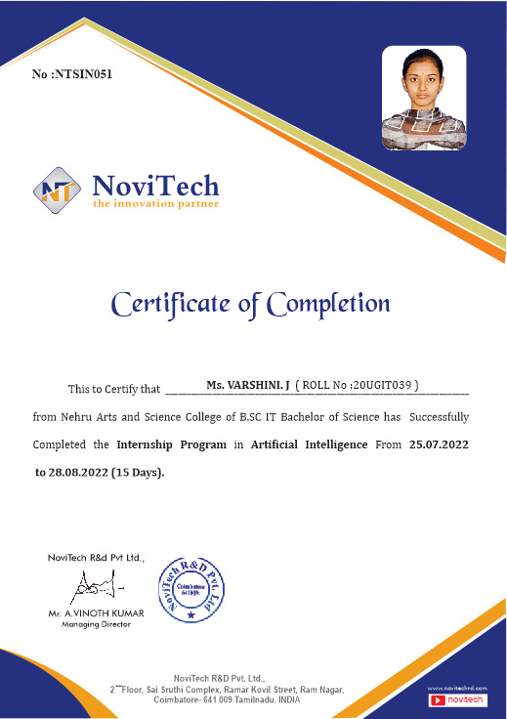

Slide 11
Mindset of the Day
We will plant positive thoughts & We will achieve positive results

Slide 12


Share the workshop link

Slide 13
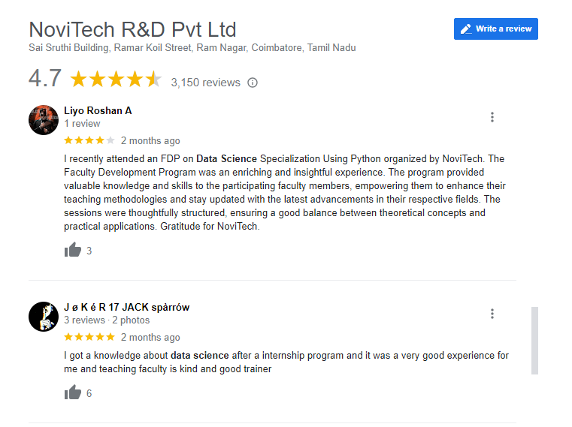

Google Review

Slide 14

Post Your Attendance

Slide 15




THANK YOU☺
NOVITECH COIMBATORE
novitechresearchanddevelopment

Slide 16
Q & A Session?

